Slide 1
SAD 8. Design, Implementation and Testing

Slide 2
Learning Objectives
Explain the purpose of the Design phase of the SDLC
Describe the three types of design strategy
Apply selection criteria to choose an appropriate design strategy for a given systems development project
Interface Design & User Experience

Slide 3
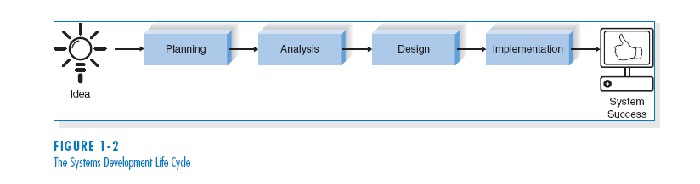
SYSTEMS DEVELOPMENT LIFE CYCLE (SDLC)

Slide 4
Design
Typical Inputs and Outputs
System Proposal
‘Design’ focuses on how to build the proposed system using technology
Design
Updated Project Plan & Schedule
Updated
Requirements Traceability Matrix
System Specification
Conveys exactly what system the design team will implement during the implementation phase
Notes:
System proposal feeds in as input from the Analysis phase

Slide 5
Design Steps
Step | Technique | Deliverable
Design Physical System Models | Design Selections (custom, purchase or outsource) Physical DFD Physical ERD | System Specification -Physical Process Models -Physical Data Model -Create Read Update Delete (CRUD) matrix -Architecture Report -H/W and S/W Specification -Interface Design -Data Storage Design -Program Design
Design Architecture | Architecture Design Hardware and Software Selection
Design Interface | User Interface System Interface Application Interface Interface Structure, Standards, Prototype, Evaluation
Design Databases and Files | Data Format Selection Denormalization Performance Tuning Size Estimations
Design Programs | Transform Analysis Program Structure Chart Program Specification
Notes:
User Interface – highest level interface. Between user and system
System Interface – interface between system components (e.g. laptop and router)
Application Interface – applications software running on system components

Slide 6
Classic Design Errors (1)
Reducing design time
Design is typically 10% of total SDLC time-line and 25% of cost
Circumstances may urgently require shorter time-frame
Solution: use RAD techniques and timeboxing
Feature creep
Changes big and small can cause significant increase and time and cost
Solution: ensure all changes are vital and users are aware of impact and cost. Try to move some changes to future versions

Slide 7
Classic Design Errors (2)
Silver bullet syndrome
Don’t be taken in - no new product can reduce cost/time by more than 25%
Solution: CASE tools that appear too good to be true probably are – say no and just go with what has been tried and tested.
Switching tools in mid-project
Solution: don’t switch or upgrade unless there is a compelling need to do so. If switch/upgrade is justified then modify project plan to allow for learning curve.

Slide 8
3 Basic Design Strategies
Custom development (from scratch) /
in-house
Purchase ‘off-the-shelf’ software package
Outsource development to third party
Notes:
Each choice has its strengths and weaknesses and each is appropriate in different situations
Some basic system alternatives include: (1) build the system in‑house using a programming language such as C or Microsoft Visual Basic; (2) purchase off‑the‑shelf packages, such as Microsoft Excel and Access, along with the necessary computer and telecommunications equipment, and use these to build the necessary systems in-house; (3) purchase custom software and a turn-key system from either a generic information systems consulting firm such as Andersen Consulting or EDS or from a specialized systems provider for the food retail or pizza retail industry; or (4) outsource the systems to an outside firm.

Slide 9
Custom Development
Pros | Cons
Allows flexibility and creativity | Requires significant staff time and effort
Consistent with existing standards and technology | May worsen existing backlogs
Builds technical skills and functional knowledge in-house | May require missing skills
 | Often costs more
 | Often takes more calendar time
 | Risk of project failure
Notes:
Develops and keeps knowledge in-house. As developers work with users their business knowledge grows and thus they are able to keep identify and use technological developments that are aligned to the business needs.
A key problem is development staff may already be over-committed and associated with numerous other development projects. Other projects will be affected and time/cost will probably be high.

Slide 10
Hardware and Software Issues
Existing Platform | New H/W & S/W
Lower costs Staff familiar with operation and maintenance Increased odds of successfully integrating system with existing applications No added costs of converting old systems to new platform or transferring data | Some software components will only run on new platform Developing system for new platform gives organisation opportunity to upgrade technology New requirements may allow organization to radically change its computing operations

Slide 11
Packaged ‘Off-the-Shelf’ Software
Pros | Cons
Available for many common business needs | Rarely a perfect fit with business needs - usually allows for customisation
Tested, proven | Changing the way features work do you allow tool to drive/reshape original business requirement?
Cost and time savings | Will need synchronizing with other application interfaces
 | May require workarounds

Slide 12
Criteria for selecting packaged software:
Cost
In-House versus purchased
Functionality
Mandatory, essential and desired features
Vendor Support
Installation
Training
Technical Support
Viability of Vendor
Flexibility
Ease of customization
Documentation
User documentation
Technical documentation
Response Time
Ease of Installation

Slide 13
Outsourced Development
Hiring an external vendor, developer, or service provider
Using experience, knowledge and expertise of other companies.
Companies typically outsource to save on costs (staff development, hardware) and time.
Very popular – a global market that exceeds £57billion
Estimated that 50% of all companies with IS budgets over £2.8m are currently outsourcing or are considering it
Pros | Cons
May reduce costs or add value | Risks include potential for losing: -confidential information -control over future development -learning opportunities

Slide 14
Selecting a Design Strategy
 | When to use Custom Dev. | When to use Off-the-Shelf | When to Outsource
Business need | The business need is unique | The business need is common | The business need is not core to the business
In-house experience | In-house functional and technical experience exists | In-house functional experience exists | In-house functional or technical experience does not exist
Project skills | There is desire to build in-house skills | The skills are not strategic | The decision to outsource is strategic
Project management | Project has highly skilled project manager and proven methodology | Project has a manager who can co-ordinate vendor’s efforts | Project has a highly skilled project manager at the level of the organisation that matches the scope of the outsourcing deal
Time frame | The time frame is flexible | The time frame is short | The time frame is short or flexible
Adapted from Dennis & Wixom (2003), p. 248, fig. 8-3.
Notes:
It only makes sense to build the system in-house when there already exists the functional and technical knowledge within the company or it is a strategic rather than operational issue i.e. Internet Sales Apps and Web Commerce app development is important to the future of the company then it makes sense to develop in-house using employees. Some skills, such as network security or installation, are more for operational rather than strategic so the company could buy a package or outsource.

Slide 15
Interface design
Interface design is the process of defining how the system will interact with external entities.
In this chapter, we focus on the design of user interfaces – how the system will interact with the users.
The design of system interfaces defines how the systems exchange information with other systems.

Slide 16
User Interface
The user interface includes three fundamental parts:
- The Navigation mechanism - the way in which the user tells the system what to do.
- The input mechanism – the way in which the system captures information.
- The output mechanism - the way in which the system provides information to the user or to other systems.
Graphical user interfaces (GUI) use windows, menus, icons, etc., and are the most common type of user interfaces.

Slide 17
PRINCIPLES FOR USER INTERFACE DESIGN
User interface design is an art.
The goal is to make the interface pleasing to the eye and simple to use, while minimizing the user’s effort.

Slide 18
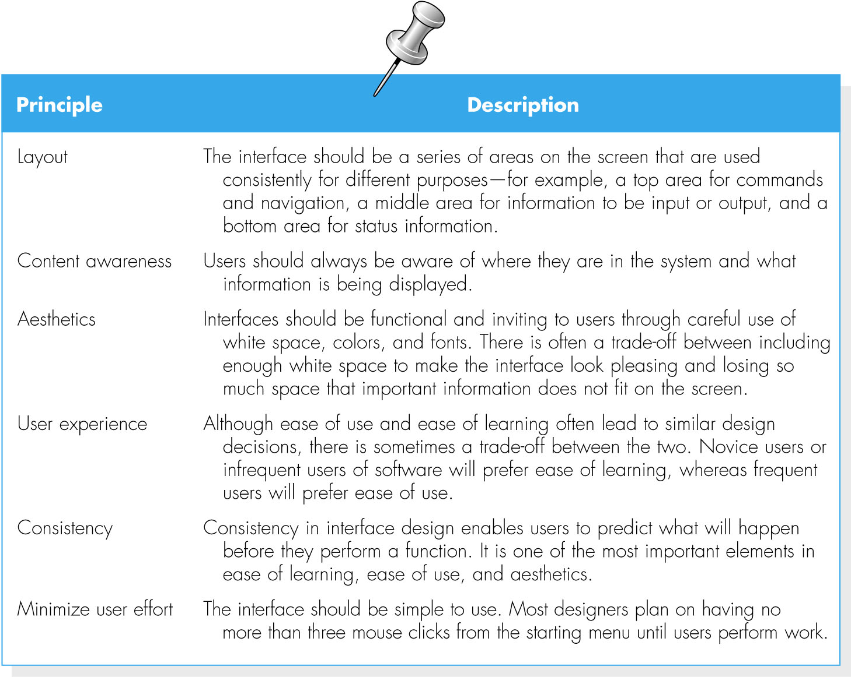
(cont’d)

Slide 19
User Experience
User experience refers to designing the user interface with the users’ level of computer experience in mind.
New users are concerned with easy of learning.
Expert users are concerned with easy of use.
Often, the two objectives are complementary and lead to similar design decisions, but sometimes there are trade-offs.

Slide 20
Consistency
Consistency usually refers to the interface within one computer system, so that all parts of the same system work in the same way. Ideally, however, the system also should be consistent with other computer systems in the organization.
Consistency enables users to predict what will happen, and to reduce the amount of learning.
Consistency occurs at many different levels.
Navigation controls;
Terminology;
Report and form design.

Slide 21
Minimize User Effort
Minimizing user effort means using the fewest possible mouse clicks or keystrokes to move from one part of the system to another.
Three-clicks rule
Users should be able to go from the start or main menu of a system to the information or action they want in no more than three mouse clicks or three keystrokes.

Slide 22
Programming – program development / computer program
5 steps of program development(computer program )
1. Review the program documentation
2. Design the program
3. Code the program
4. Test the program
5. Complete the program documentation

Slide 23
Review the program documentation
The programmer should review the program documentation that was prepared during previous SDLC phase ( system design )
The program documentation should consists of report layout, source document, data dictionary, screen layout, input & output layout.

Slide 24
Design program
The programmer typically uses several program tools aids such as :-
Hierarchy charts
Program flowcharts
Pseudo code

Slide 25
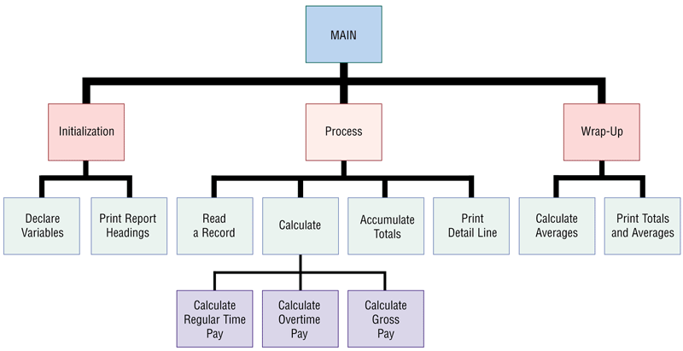
What is a hierarchy chart?
Shows program modules graphically
Also called structure chart

Slide 26
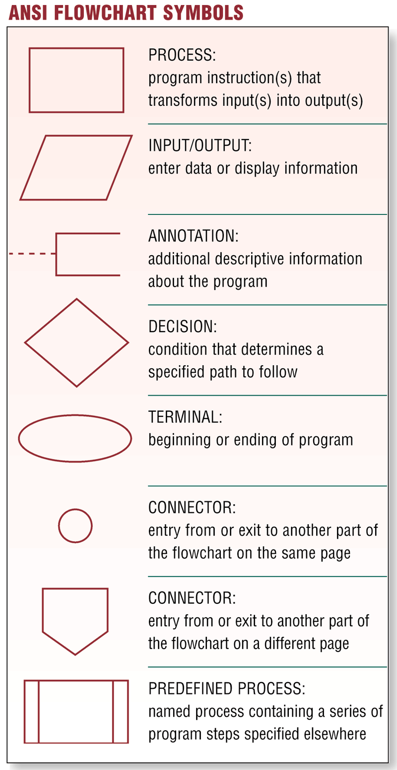
What is a program flowchart?
Graphically shows logic in solution algorithm

Slide 27
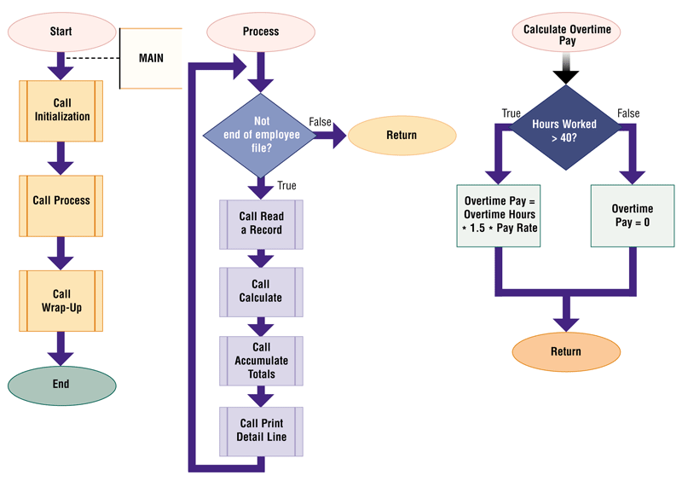
An example of a flowchart?

Slide 28
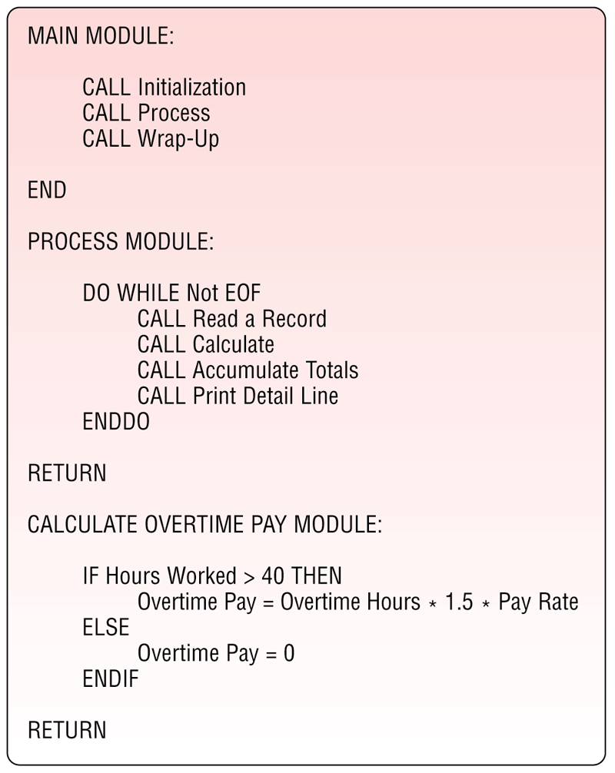
What is pseudo code?
Uses condensed form of English to convey program logic

Slide 29
Code the program - using several programming languages
Cobol
C
C++
Visual Basic
Java
Visual Studio
Delphi – web application
Power Builder – web application
SQL – query language

Slide 30
TESTING

Slide 31
Software/Program Testing
A method to assess the functionality of a software program.
It involves checking whether the actual software matches the expected requirements and ensures that the software is free of bugs.
The purpose of software testing is to identify errors, faults, or missing requirements in contrast to the actual requirements.
By systematically identifying and fixing issues, software testing helps deliver high-quality software that performs as expected in various scenarios

Slide 32
Software/Program Testing
Testing is intended to show that a program does what it is intended to do and to discover program defects before it is put into use.
When you test software, you execute a program using artificial data.
You check the results of the test run for errors, anomalies or information about the program’s non-functional attributes.
Can reveal the presence of errors not their absence.
Testing is part of a more general verification and validation process, which also includes static validation techniques.

Slide 33
Test the program
Testing helps ensure that the system performs as outlined in the specifications.
Documentation provides information to make the system easier to use and repair.

Slide 34
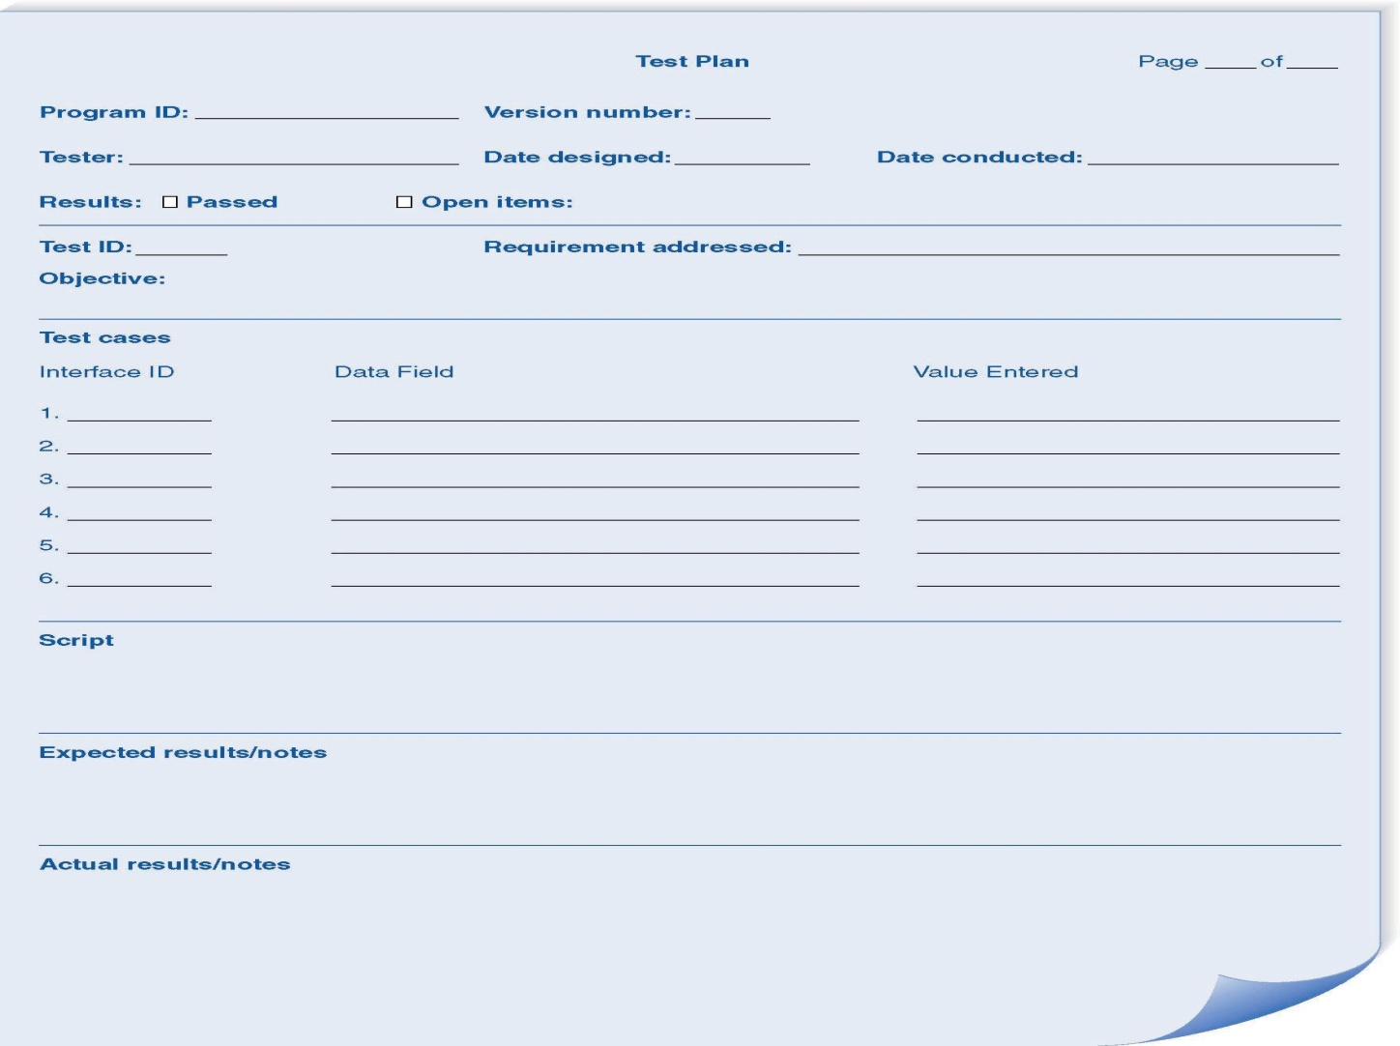
Test Plan

Slide 35
Categories of Testing
Unit testing
Tests each module to assure that it performs its function
Integration testing
Tests the interaction of modules to assure that they work together
System testing
Tests to assure that the software works well as part of the overall system
Acceptance testing
Tests to assure that the system serves organizational needs

Slide 36
Unit Testing
Black Box Testing
Focuses on whether the unit meets requirements stated in specification
White-Box Testing
Looks inside the module at actual code

Slide 37
Integration Testing
User interface testing
Tests each interface function
Use-scenario testing
Ensures that each use scenario works correctly
Data flow testing
Tests each process in a step-by-step fashion
System interface testing
Ensures data transfer between systems

Slide 38
System Testing
Requirements Testing
Ensures that integration did not cause new errors
Usability Testing
Tests how easy and error-free the system is in use
Security Testing
Assures that security functions are handled properly
Performance Testing
Assures that the system works under high volumes of activity
Documentation Testing
Analysts check the accuracy of documentation

Slide 39
User Testing
User or customer testing is a stage in the testing process in which users or customers provide input and advice on system testing.
User testing is essential, even when comprehensive system and release testing have been carried out.
The reason for this is that influences from the user’s working environment have a major effect on the reliability, performance, usability and robustness of a system. These cannot be replicated in a testing environment.

Slide 40
Acceptance Testing
Alpha Testing
Performed by users to assure they accept the system; frequently repeats earlier tests
Beta Testing
Uses real data, not test data. Actual users monitor for errors or needed improvements.

Slide 41
The Acceptance Testing Process

Slide 42
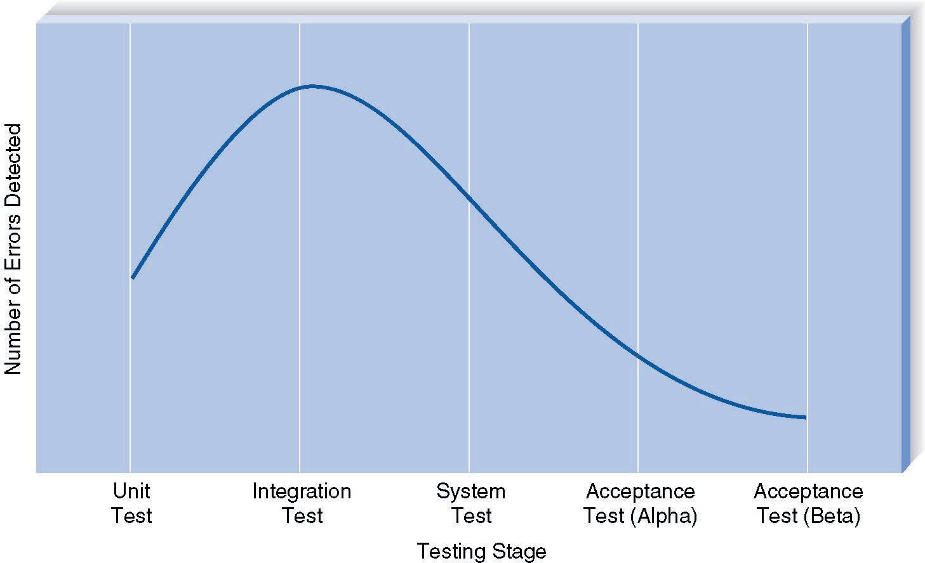
Error Discovery Rates By Test Stage

Slide 43
DEVELOPING DOCUMENTATION

Slide 44
Types of Documentation
System Documentation
Intended to help programmers and analysts understand and maintain the system after it is installed
User Documentation
Intended to help users operate the system

Slide 45
Summary
The project manager must assign tasks to programmers, assure coordination of program development and schedule code production and adjust the schedule as development continues.
Test planning must be done carefully and a variety of methods all contribute to developing quality software.
Documentation should begin well before the completion of coding and testing and address needs of maintenance programmers and system users.

